Slide 1
COVID-19 Cases-part-4
File created on: 28-03-2020 20:30:32

Slide 2
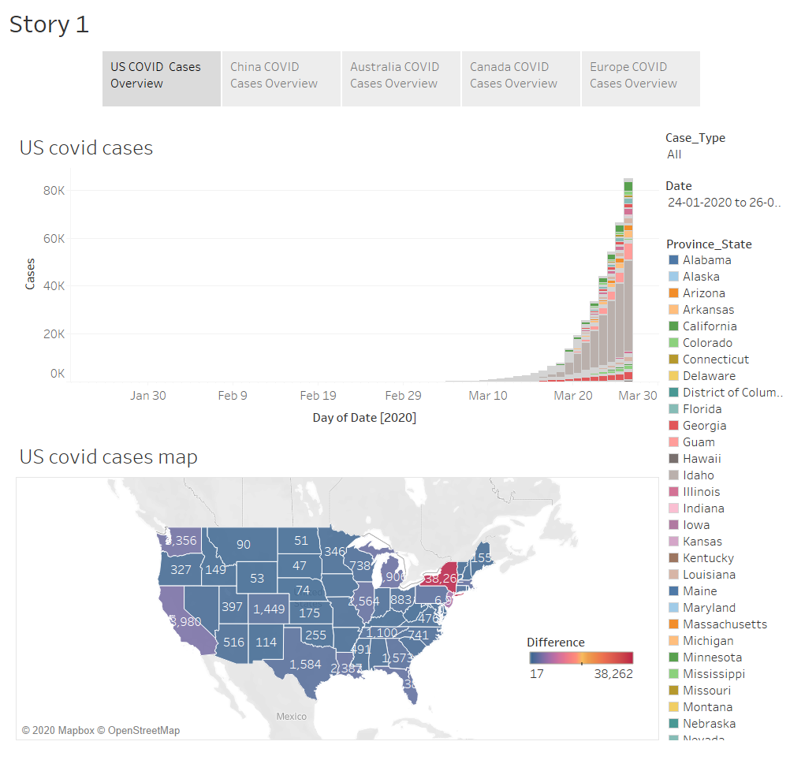

Slide 3
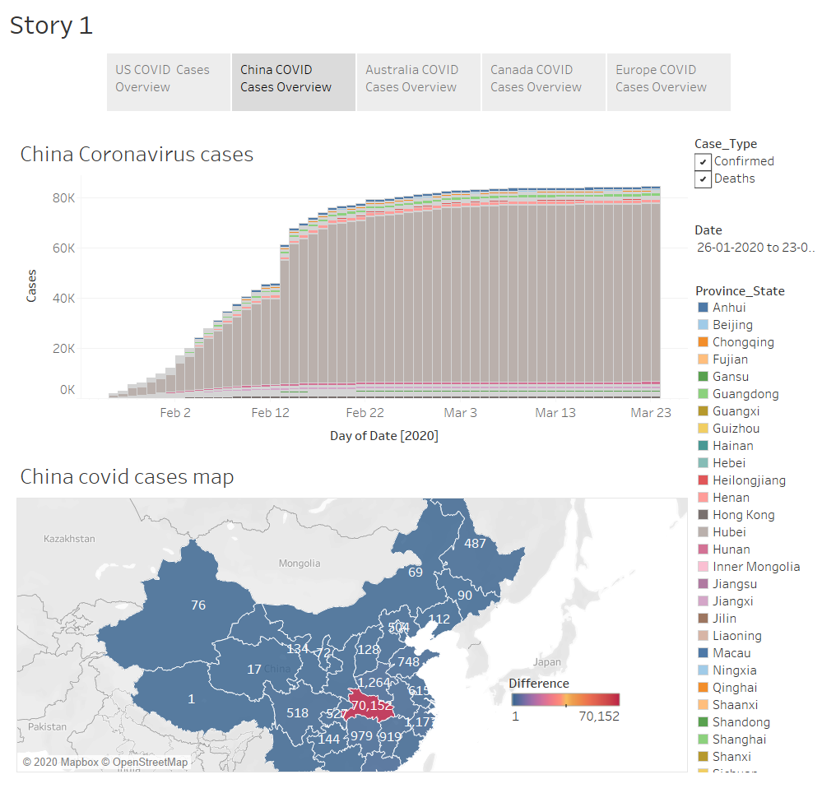

Slide 4
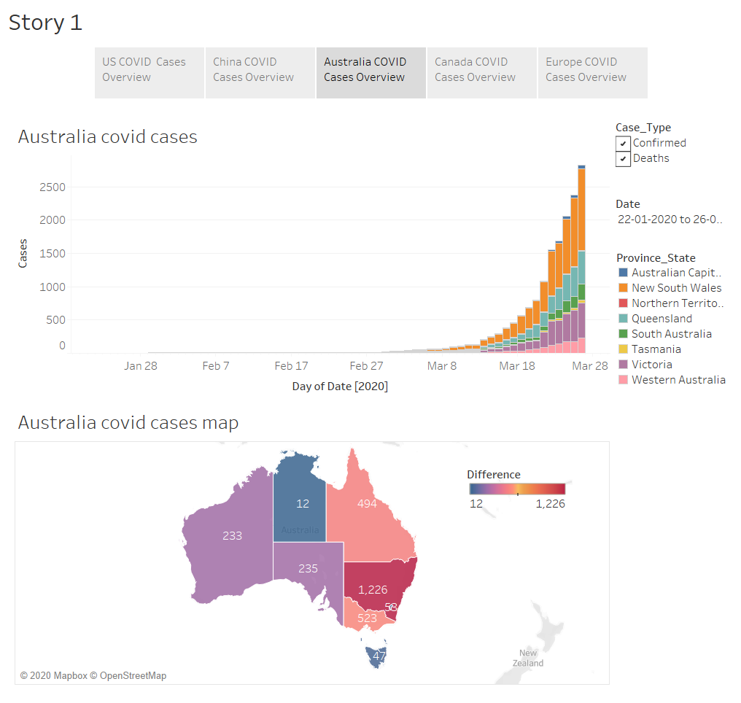

Slide 5
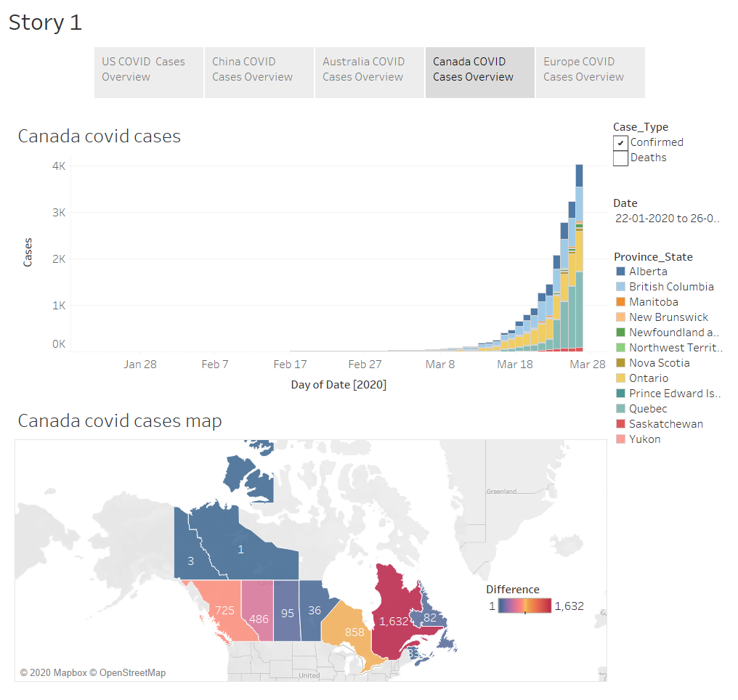

Slide 6
